Slide 1
Spark Core
Exploring in depth

Slide 2
What will we cover
Expectations from a data processing framework
In depth exploration of Spark Core concepts and features
Operations in Spark Core Applications
Performing aggregations and joins
Caching
Distributed Variables
Use cases
Using combiners
Secondary Sorting
Optimisations

Slide 3
Prerequisite
Python

Slide 4
Importance of Data
Bank
Spending Patterns
Credit Score
Mobility
Spreading the reach
Analyse areas of growth
Telematics
Retail
Clickstream
Consumer behavior/loyalty/segmentation
Telecommunication
Network optimisation (throughput/latency)

Slide 5

Importance of data engineering teams
Data Engineering
Data Science
Prediction
BI

Slide 6
Expectations from a data processing framework
Timeliness
Timely availability of the data analysis result
Reliability
Tolerant to temporary internal failures
Verifiable result
Integration
Connects well with outside world eg: external storage, various databases
Handling diverse data processing requirements
Handles batch processing, stream processing, machine learning analysis like recommendation
Maintainability and Operationality
Easy to upgrade, customize and operate
Scalability
Capable to scale for high volume and velocity of data at reasonable cost

Slide 7
Next:
Introduction to MapReduce

Slide 8
Getting maximum temperature
2020-01-10,123212,14
2019-02-11,223221,15
2020-03-12,423224,16
2018-02-14,623221,11
2020-01-11,332262,12
2019-01-12,223221,13
2020-02-10,123289,18
2019-02-10,423202,10
year_max_temp_dict = {}
for line in open('/tmp/weather.csv', 'r').readlines():
full_date, zip, temperature = line.split(",")
temperature = int(temperature)
year, month, day = [int(field) for field in full_date.split("-")]
if year not in year_max_temp_dict:
curr_max_temp = temperature
else:
existing_temp = year_max_temp_dict[year]
curr_max_temp = max(temperature, existing_temp)
year_max_temp_dict[year] = curr_max_temp
for year in year_max_temp_dict:
print("Maximum temperature for the year {} is {}".format(year, year_max_temp_dict[year]))

Slide 9
Getting maximum temperature
Input Records
{}
Evolution in the content of the dictionary to keep track of the maximum temperature for every year
2020-01-10,123212,14
{2020: 14}
2019-02-11,223221,15
{2019: 15,
2020: 14}
2020-03-12,423224,16
{2019: 15,
2020: 16}
{2018: 11,
2019: 15,
2020: 16}
2018-02-14,623221,11
{2018: 11,
2019: 15,
2020: 16}
2019-01-12,223221,13

Slide 10
Issues with single process application
Large file may not fit on the local machine
Even if we find a way to read large file:
Low speed of execution
May not have enough memory to keep the dictionary if keys are in huge number
Need a better way to perform complex computations on data at petabyte scale

Slide 11
Map Reduce: Flow of Operations
SELECT year, MAX(temperature) FROM <table> GROUP BY year;
Map Phase
Work on the input dataset
Run multiple processes in parallel spread across multiple machines of a cluster, each working on mutually exclusive portion of the data
Produce output in the form of (key, value)
Key: field over which aggregation should take place [here: it is year]
Value: field to be aggregated [here: it is temperature]
Shuffle
Collect all the values for each key and send them to the next phase ie. reduce
Reduce Phase
Get the key and the list of the values
Iterate over the values to generate the aggregate.

Slide 12
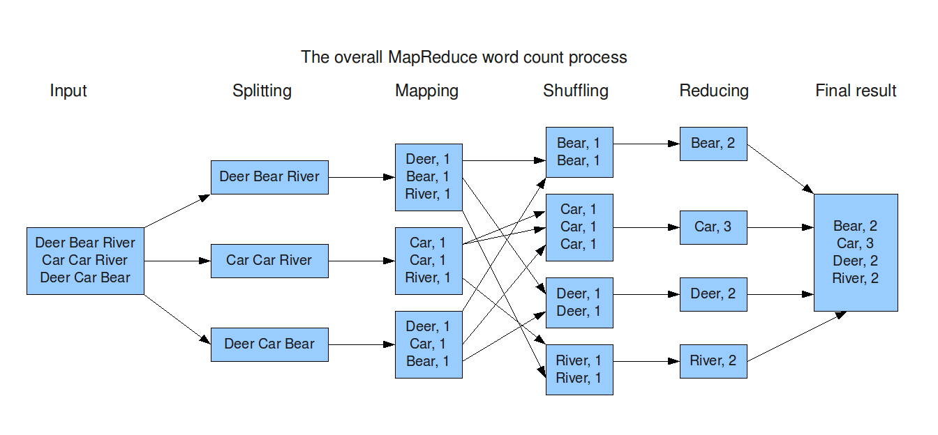
Map Reduce: Flow of Operations

Slide 13
Map Reduce: Flow of Operations https://www.analyticsvidhya.com/blog/2022/05/an-introduction-to-mapreduce-with-a-word-count-example/
Reads input data and produces (key, value) output
Provides to the reduce input, all values clubbed together for each key
Reads all values of a key and generates aggregated output
Map
Shuffle
Reduce

Slide 14
Map Reduce: Getting maximum temperature
Read each line
Generate year as key and temperature as value
Collect all the values for each key
Iterate over all the values to generate aggregate
2020-01-10,123212,14
2019-02-11,223221,15
2020-03-12,423224,16
Mapper
2020, 14
2019, 16
2020, 16
2018, 11
2020, 18
2018, [11]
2020, [14, 16, 18]
2018-02-14,623221,11
2020-01-11,332262,12
2019-01-12,223221,13
Mapper
2018, 11
2020, 12
2019, 13
2019, 16
2019, [16, 13, 10]
2020-02-10,123289,18
2019-02-10,423202,10
Mapper
2020, 18
2019, 10

Slide 15
Map Reduce: Generate word count
Read each line
Generate word as key and 1 as value
Collect all the values for each key
Iterate over all the values to generate sum
apple orange
melon apple
banana banana
Mapper
apple, 1
orange, 1
melon, 1
apple, 1
banana, 1
banana, 1
apple, 5
orange, 4
apple, [1,1,1,1,1]
orange, [1,1,1,1]
orange orange
apple banana
apple orange
Mapper
orange, 1
orange, 1
apple, 1
banana, 1
apple, 1
orange, 1
banana, 3
melon, 4
banana, [1, 1, 1]
melon, [1, 1, 1, 1]
melon melon
melon apple
Mapper
melon, 1
melon, 1
melon, 1
apple, 1

Slide 16
Why MapReduce
Process massive amount of data
Use of commodity hardware
Jobs can succeed even if some tasks fail (as tasks are re-launched or re-tried)
Speculative Execution
Support for config to further tune or customize the behaviour
Loose coupling with cluster manager

Slide 17
Why NOT MapReduce
Increased latency due to high usage of local disk (for map output) or HDFS/similar storage (for reduce output)
Not optimised for iterative processing
Not suited for interactive queries
Not designed for low latency jobs like streaming/real time
Need different tools for different processing
Hive of SQL
Mahout for Machine Learning
Giraph for Graph Processing

Slide 18
Next:
Introduction to Spark

Slide 19
What is Spark
Computing Engine
Provides fast, in-memory, distributed computation without being strongly coupled to a specific storage system
Can connect to wide variety of storage systems
Unified Data Processing
Same engine for
Streaming
Machine learning, and
SQL
Consistent API
Set of libraries for big data
Supports standard (like Spark SQL, MLib) libraries, and
third party libraries

Slide 20
Spark Ecosystem
Spark SQL + DataFrames
Streaming
MLib
GraphX
Spark Core API
R
SQL
Python
Scala
Java

Slide 21
Why Spark
Evolution of Map Reduce, hence consists of the benefits of Map Reduce and tries to address the shortcomings.
Parallel Processing
Can handle huge data volume by parallel processing on worker machines (called nodes)
Linearly scales with addition of more machines
Can work on commodity hardware, no requirement of any specialized machine
Low disk I/O
Low usage of local disk or HDFS/similar storage (for intermediate output)
Hence, optimised for iterative processing
Designed for low latency jobs like streaming/real time
Unified data processing
Supports wide variety of data processing requirements with the same computation engine

Slide 22
Why Spark
Support multiple languages
Out of the box support for different languages: Scala, Python, Java, R and SQL
Active
Most active open source project in its domain
Integration
Seamless integration with wide variety of data storages
Compact
Less lines of code, more focus on business logic

Slide 23
Next:
Concepts of Spark: RDD

Slide 24
Terminology to be discovered
Resilient Distributed Dataset
Partitions
Transformations
Tasks
Lineage

Slide 25
Variable manipulation
u = 1
v = u * 2
w = 10
x = v + w
Variable Manipulation
u = [10, 20, 12, 14]
v = map(lambda i: i*2, u)
w = [10, 11, -1, 18]
x = map(lambda (i, j): i + j, zip(v,w))
Variable Manipulation

Slide 26
Resilient Distributed Dataset (RDD)
Construct a distributed dataset where different portions (called partitions) of the file can be processed in parallel
Process the partitions of the previous dataset in parallel and construct a new dataset containing only the sales value
Process previous dataset in parallel and construct a new dataset by adding the sales inside each partition
A file containing city, country and sales
Process previous dataset in parallel and construct a the final dataset by adding the content of each partition
berlin, germany, 10
rome, italy, 28
munich, germany, 12
london, uk, 14
venice, italy, 32
manchester, uk, 18
10
28
12
14
32
18
38
Objective:
Get the total sales
Data Collection
114
Benefits:
Ability to process huge volume of data
Faster processing
26
50

Slide 27
Resilient Distributed Dataset (RDD)
Construct a distributed dataset where different portions (called partitions) of the file can be processed in parallel
Process the partitions of the previous dataset in parallel and construct a new dataset containing where country matches ‘germany’
A file containing city, country and sales
Objective:
Get all records for germany
berlin, germany, 10
rome, italy, 28
munich, germany, 12
london, uk, 14
venice, italy, 32
manchester, uk, 18
berlin, germany, 10
munich, germany, 12

Slide 28
Resilient Distributed Dataset (RDD)
Construct a distributed dataset where different portions (called partitions) of the file can be processed in parallel
Process the partitions of the previous dataset in parallel and construct a new dataset containing the country and sales value
Process previous dataset in parallel and construct a new dataset by collecting all the values for a country (involves shuffle)
A file containing city, country and sales
Data Shuffling
Objective:
Get the total sales for each country
berlin, germany, 10
rome, italy, 28
munich, germany, 12
london, uk, 14
venice, italy, 32
manchester, uk, 18
germany, 10
italy, 28
germany, [10, 12]
germany, 12
uk, 14
uk, [14, 18]
italy, 32
uk, 18
italy, [28, 32]

Slide 29
Defining RDD
RDD stands for Resilient Distributed Dataset
It defines functions to process/manipulate the data
It partitions the input data, so that each partition can be processed in parallel.
Different partitions can be processed on different machines in a cluster
If processing of any partition fails due to temporary issues like network outage or machine getting down, it is automatically restarted, making it resilient to recoverable failures.
RDDs are immutable, once created we need to construct another RDD if we wish to change the data referred by it.

Slide 30
Creating RDDs
RDBMS
FILE
Constructing an RDD
RDD

Slide 31
Variable manipulation and lineage
u = 1
v = u * 2
w = 10
x = v + w
Lineage / Dependency
Variable Manipulation
u
v
x
u = [10, 20, 12, 14]
v = map(lambda i: i*2, u)
w = [10, 11, -1, 18]
x = map(lambda (i, j): i + j, zip(u,w))
w
Variable Manipulation

Slide 32
RDD lineage
Whenever an RDD is created or transformed, the lineage information is updated and kept in-memory by spark.
This lineage keeps the information about what has to be done when result is asked for.
There are two types of operations on an RDD, which we’ll discuss in detail later:
Transformation: They update the lineage
Action: They execute the actual lineage
Lineage helps in this concept of lazy evaluation (more coming up in later videos)
Lineage is essential to avoid reprocessing entire source dataset if one of the partitions of the RDD fails.

Slide 33
RDD Lineage https://sparkbyexamples.com/spark/what-is-lineage-graph-in-spark/ https://www.youtube.com/watch?v=1Yh5S-S6wsI
Input
RDD constructed by to read different portions of the source
RDD constructed by filtering records
RDD constructed by transforming each record
RDD constructed by aggregating on some key

Slide 34
RDD Q&A
Q1. Why do we need to create multiple RDDs. Why can’t we update existing RDD?
RDDs are immutable, once created they can not be modified. To update the RDD, reconstruct it or create another RDD to transform it. Also, RDDs do not contain the data, and computation happens only when you need the final output (when you call the action [more to be discussed later]), so reconstructing an RDD before the trigger has no performance penalty. Also, Spark performs optimisation to compact operations together, many a times, adding extra transformation (not involving shuffle) also does not impact the performance.
Q2. If multiple RDDs are created, one corresponding to each transformation, wouldn’t the data be duplicated across each RDD?
RDDs do not contain the data, rather they maintain the pointer to the actual data (for the RDD reading from the source) or the information about what transformation to perform on the parent RDD. The RDD lineage maintains the information about what transformation data will undergo when action [more to be discussed later] is called. When the user wants the final output, pipeline (lineage) of the RDD is triggered and data is processed on the fly. So, intermediate output may be produced, but they will be temporary and the entire data of the source won’t be duplicated.

Slide 35
RDD Q&A
Q3. What does resilience mean in RDD?
Each partition is processed in parallel and one of the process fails, it is automatically restarted (for the configured number of times). Also, only the portion of the data that process was supposed to read will be scanned and the entire source won’t be re-read. The lineage is traced back and not all the parent RDDs are recomputed, only the partitions of the parent RDD which had any role in creating the failed partition of the child RDD are recomputed. So, failure while processing a partition is handled transparently without user even noticing it on high level.
Q4. What is benefit of being distributed for an RDD?
Each partition is processed in parallel and one of the process fails. For each partition, one task [more to be discussed later] is executed by executor [more to be discussed later] (a process running on the worker machines). These tasks can be spread across multiple machines of the cluster. Hence, being distributed helps getting the results of data analysis faster or meeting the timelines when performing heavy-weight data analysis by scaling out the cluster.

Slide 36
Next:
Concepts of Spark: Architecture

Slide 37
Terminology to be discovered
SparkContext
SparkConf
Worker Nodes
Executors
Driver Machine
Cluster Managers

Slide 38
Spark Context
Main entry point for Spark functionality.
A SparkContext represents the connection to a Spark cluster, and can be used to create RDDs, accumulators and broadcast variables on that cluster.
With default constructor, it loads settings from system properties
SparkContext()
It can be constructed with a Spark Config object as a parameter describing the application configuration.
SparkContext(SparkConf config)
Any settings in this config overrides the default configs as well as system properties.

Slide 39
Spark Context
Only one SparkContext should be active per JVM.
You must stop() the active SparkContext before creating a new one.
Some of the methods available on the SparkContext are:
textFile(String path, int minPartitions)
Read a text file from HDFS, a local file system (available on all nodes), or any Hadoop-supported file system URI, and return it as an RDD of Strings.
addJar(String path)
Adds a JAR dependency for all tasks to be executed on this SparkContext in the future.
addFile(String path)
Add a file to be downloaded with this Spark job on every node.

Slide 40
Cluster Manager
An external service for acquiring resources on the cluster (e.g. standalone manager, Mesos, YARN)
The system currently supports several cluster managers:
Standalone
simple cluster manager included with Spark that makes it easy to set up a cluster.
Apache Mesos
a general cluster manager that can also run Hadoop MapReduce and service applications.
Hadoop YARN
the resource manager in Hadoop 2.
Kubernetes
an open-source system for automating deployment, scaling, and management of containerized applications.
A third-party project (not supported by the Spark project) exists to add support for Nomad as a cluster manager (now deprecated).

Slide 41
Spark Architecture
There are lots of worker nodes where a service called executor runs. It owns resources and runs tasks within it. There could be multiple executors running on one machine.
To run on a cluster, the SparkContext, created on the driver node can connect to several types of cluster managers (either Spark’s own standalone cluster manager, Mesos or YARN), which allocate resources across applications.
Once connected, Spark acquires executors on nodes in the cluster, that run computations and store data for the application.
Next, it sends your application code (defined by JAR or Python files passed to SparkContext) to the executors.
Finally, SparkContext sends tasks to the executors to run.

Slide 42
Spark Architecture
Worker Node
Executor
Cache
Task
Task
Driver Program
Spark Context
Cluster Manager
Worker Node
Executor
Cache
Task
Task

Slide 43
Core Concepts of Spark
RDD
Resilient (fault tolerant)
Distributed
Dataset
Spark Context
Represents the connection to a Spark cluster
Used to create RDDs, accumulators and broadcast variables on that cluster
Cluster Manager
Allocates resources to the application
Provides scheduling of the applications on shared cluster

Slide 44
Next:
Download and Installation

Slide 45
Ways to practice
Locally using shell
Locally using PyCharm
Running on a single node EC2
Running on a cluster of nodes (EMR)
Databricks Notebook (single node 15 GB spark cluster)

Slide 46
Running Spark locally
Install java8
Download spark
Untar it
Start using bin/pyspark from spark directory
SparkContext object is available as sc
When pyspark is running, the UI is available at localhost:4040

Slide 47
Locally inside PyCharm
Prerequisites: java8, python
Install pycharm
Create a python project
Install the package pyspark (optionally install psutil as well)
Run spark application
SparkContext object is not automatically available, so manually create it:
from pyspark import SparkContext, SparkConf
// create SparkConf object
conf = SparkConf()
// set configuration on the SparkConf object
// create SparkContext object
sc = SparkContext(conf=conf)

Slide 48
On EC2
Create an account on aws console (https://console.aws.amazon.com/)
Launch an EC2 machine (can choose t2.micro, as it comes free)
It takes few minutes for the machine to be up
Login to the machine using the key
Install java8
Download spark
Untar it
Start using bin/pyspark from spark directory
When pyspark is running, the UI is available at <machine_host>:4040
When not in use, terminate the machine

Slide 49
Running on cluster: EMR
Create an account on aws console (https://console.aws.amazon.com/)
Create an EMR cluster
Choose the number and type of machines for the cluster
It may take few minutes (sometimes upto 30 minutes) for the cluster to be up
Login to the master machine using the key
Start using pyspark using pyspark
The YARN resource manager runs on the master machine at port 8088
We’ll see examples around this later

Slide 50
Databricks Notebook: Free single node cluster
Create an account in Databricks notebook (community edition), which is free
Once logged in, can further
Create a single node cluster, it may take few minutes for the cluster to be up
Create a notebook and attach it to the cluster just created
In the notebook, SparkContext object is available as sc
Can upload data files to your account
Cluster is automatically terminated if not in use for 2 hours

Slide 51
Next:
Our first Spark Program

Slide 52
To be discussed
Python built-in functions:
map
filter
reduce
Creating an RDD
parallelize
textFile
Applying transformations on RDD
map
filter
Taking result by applying actions on RDD
Performing aggregations on RDD

Slide 53
Next:
Concepts of RDDs

Slide 54
To be discussed
Lazy Evaluation
Types of transformations
Narrow
Wide
Job, Stage and Task
Exploring the Spark UI

Slide 55
Next:
Partitioners

Slide 56
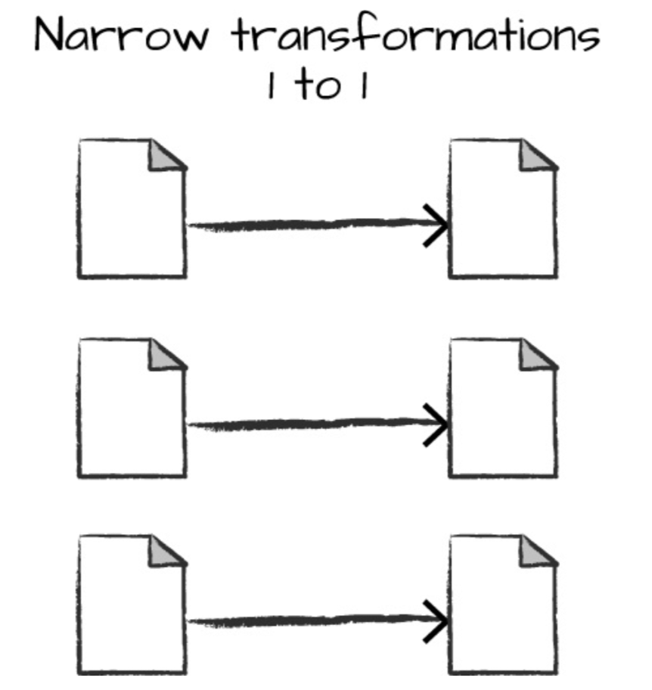
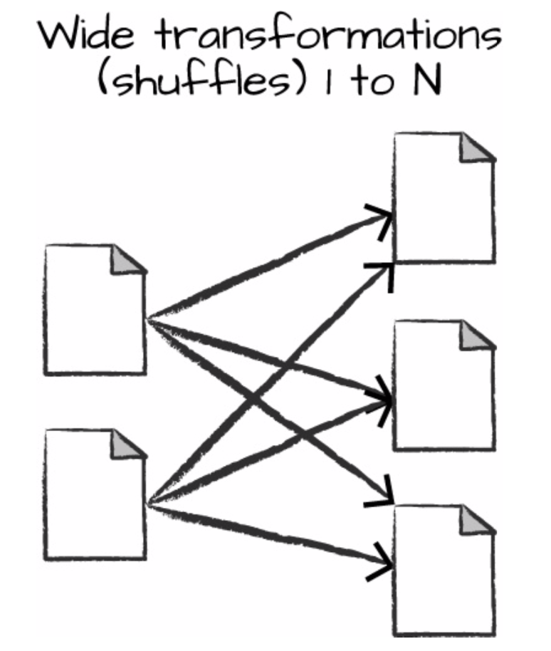
Learnt so far

Slide 57
Learnt so far
Jobs : depends on actions
Stages : depends on wide transformations
Tasks : depends on partitions in the RDD/DataFrame

Slide 58
To be discussed
Need of partitioners
Types of partitioners
Hash Partitioner
Range Partitioner
Accessing the files of DBFS

Slide 59
Hash Partitioner
Partition 0
10
20
13
14
15
17
18
13
10
20
14
18
The child partition is determined by
hash(element) % number_of_partitions
For integer num, let hash(num) be the num itself
Eg: if num = 7 and number of partitions = 2 then it will go to partition hash(7) % 2 (ie. 7 % 2, which equals 1)
13
15
17
13
Partition 1

Slide 60
Hash Partitioner
Partitioner decides which element of the parent goes to which partition of the child.
Shuffle operations use hash partitioner to randomly allocate partition to elements
reduceByKey [partitioner is applied on the key, so that all values are collected together in the same partition]
groupByKey [partitioner is applied on the key, so that all values are collected together in the same partition]
Data can be skewed with default hash partitioner. Eg: if we have only even numbers and use 2 partitioners, then entire data goes to partition 0.

Slide 61
Range Partitioner
Partition 0
10
20
13
14
15
17
18
13
10
13
13
To split the items in N partitions by range, we need (N - 1) boundary points.
Eg: if we have data from 10 to 18, then to divide by range into 2 partitions, we need 1 boundary point.
Let the boundary point be the middle (10 + 18) / 2 == 14
Then data < 14 will go to partition 0 and data >= 14 will go to partition 1
20
14
15
17
18
Partition 1

Slide 62
Range Partitioner
HashPartitioner is not useful when sorting the data. Local sorting of data can be achieved but for global sorting we need RangePartitioner
To split 1-D line into N ranges, we need N-1 boundary points.
A sampling (considering the frequency and values of the data points) is needed to generate the boundary points to distribute the load better.

Slide 63
Get the name of the partitioner function used
Get the name of the partitionFunc
rdd.partitioner.partitionFunc

Slide 64
Accessing the files of DBFS
Add prefix /dbfs and access using python file handling functions
print(open("/dbfs/FileStore/output/file.csv", "r").read())
Use %fs
%fs
ls /FileStore/output/sorted_max_temperature
%fs
head /FileStore/output/max_temperature/part-00000

Slide 65
Next:
[Hands On]
RDD Operations

Slide 66
To be discussed
Explore different operations on RDD without aggregations
Working on per partition basis

Slide 67
Some transformations on the RDD
map | Apply a function on each item to get a transformed item
filter | Filter out items based on a function
distinct | Return an RDD containing only the distinct values.
sortBy | Sort the items based on the item value or a function
mapPartitions | Apply transformation on each partition. The function can access the items through an iterator and returns another transformed iterator
mapPartitionsWithIndex | Apply transformation on each partition. The function also accesses the index of the partition

Slide 68
Some actions on the RDD
reduce | Apply reduce operation on all elements. The function accepts two elements at a time and returns final result based on the aggregation performed.
collect | Get all the result to driver as a list. Can lead to out-of-memory at driver for large datasets.
take(n) | Get n elements of the RDD to the driver. Only the partitions needed to get the result are evaluated.
count | Returns the total number of elements in the RDD.
first | Get the first element of the RDD
countByValue | Returns a dictionary with element as the key and the number of times it appears as value
max | Get the maximum of all the elements
min | Get the minimum of all the elements
takeOrdered(n) | Returns n elements in ascending order

Slide 69
Working on per partition basis using mapPartitions
Sometime, performing an one-time activity before processing each partition improves performance. The one-time activity could be creating a connection or access to a shared resource.
If we wish to send the records of an RDD to MySQL (or any other RDBMS)
For each record:
Open a connection
Send the record
Close the connection
For each partition:
Open a connection
Send all the records one by one
Close the connection
More efficient since connection is opened and closed one for each partition, not for each record

Slide 70
Working on per partition basis using mapPartitions
RDD
Executor
Do something before reading the content of the parent RDD
Get access to the iterator and process records of the parent one by one.
Return an iterator of processed data
Do something when the processing finishes
Partition 0 having 4 records
Iterator
Do something before reading the content of the parent RDD
Get access to the iterator and process records of the parent one by one.
Return an iterator of processed data
Do something when the processing finishes
Partition 1 having 4 records
Iterator

Slide 71
Next:
[Hands On]
Aggregations with RDD

Slide 72
To be discussed
Explore different aggregations on RDD

Slide 73
Creating a pair RDD
From an RDD of elements, call map to transform it into pairs
Call keyBy on an RDD to pass the function to generate the key
To get a RDD grouped by a key, use groupBy and pass the function to return the key

Slide 74
Transformations on Pair RDD
mapValues | Apply map transformation on the values. It is a narrow transformation.
flatMapValues | Apply flatMap transformation on the values. The function returns an iterator and all values of the iterator forms a pair with the key in the child RDD. It is a narrow transformation.
keys | Returns all the keys
values | Returns all the values
sortByKey | Returns a sorted RDD based on the key
reduceByKey | Perform a reduce operation on all values of a key. Performs combine operation locally
groupByKey | Collect all values for a key
subtractByKey | Return elements from the left RDD corresponding key is not found in the right RDD
cogroup | For each matching key, get a tuple of list of values from the left and a list of values from the right side

Slide 75
Actions on Pair RDD
countByKey | Count the number of elements for each key, and return the result to the master as a Map
collectAsMap | Returns a dictionary with key and its latest value in the RDD as the fial value
lookup | Get all the values of the key being looked up

Slide 76
Next:
[Hands On] Joining RDDs

Slide 77
To be discussed
Developing the intuition of joins
Different types of joins on RDDs

Slide 78
Joining RDDs
Shuffle will collect values from both RDDs with matching keys
101, John
102, Matthew
103, Aakash
104, Sandeep
105, Sakura
106, Abed
107, Mary
108, Kamla
101, [John, USA]
103, [Aakash, India]
105, [Sakura, Japan]
107, [Mary, Germany]
102, [Matthew, Sri Lanka]
104, [Sandeep, UAE]
106, [Abed, Australia]
108, [Kamla]
110, [Australia]
For keys with values only in one of the RDDs, outer join can produce result
Pair RDD of (user_id, name) with 2 partitions
101, USA
108, UK
105, Japan
102, Sri Lanka
103, India
104, UAE
107, Germany
110, Australia
Pair RDD of (user_id, location) with 2 partitions

Slide 79
Next:
Broadcast Variables

Slide 80
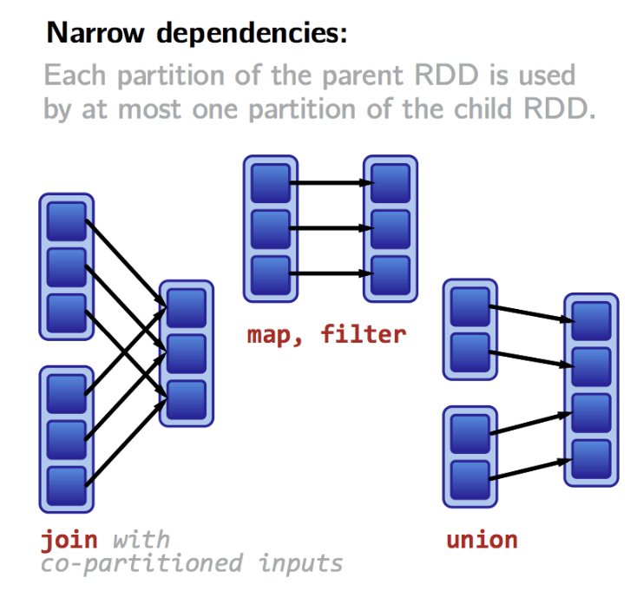
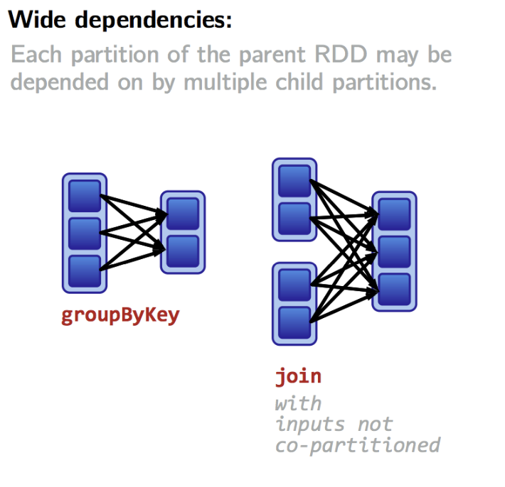
Learnt so far
Notes:
Narrow transformation: One partition of the child is dependent on a specific partition(s) of the parent. No shuffle is caused due to mutually exclusive and direct mappings.
Wide transformation: One partition of the child depends on all the partitions of parent. Causes shuffle

Slide 81
Use Case of avoiding shuffle during join
orders
user_id: 10 bytes
item_id: 10 bytes
city: 10 bytes
price: 4 bytes
quantity: 4 bytes
discount: 4 bytes
1 record: 10 + 10 + 10 + 4 + 4 + 4 = 42 bytes
With 50 Mn daily transactions, total monthly transaction = 50 Mn * 30 = 1.5 Bn
Total size of orders files = 1.5 * (10 ^ 9) * 42 bytes = 63 GB
city_mapping
city: 10 bytes
continent: 10 bytes
1 record: 10 + 10 = 20 bytes
With around 400,000 cities, total size = 4 * (10 ^ 6) * 20 bytes = 80 MB
Objective: We need to enrich the orders table with continent information.
For this orders file has to joined with city_mapping
One year worth of this simplified data is more than 750 GB
SELECT o.user_id, o.item_id, o.city, c.continent, o.price, o.quantity, o.discount
FROM orders o
INNER JOIN cities c
ON o.city = c.city

Slide 82
Joining RDDs to get the result
Create pair RDDs on city and shuffle to collect both corresponding values from each.
U_101, I_101, city_1, 100, 1, 20
U_102, I_102, city_2, 40, 2, 0
U_103, I_101, city_3, 20, 5, 0
U_102, I_101, city_2, 300, 10, 10
U_104, I_103, city_4, 500, 9, 50
U_101, I_103, city_1, 10, 7, 0
U_104, I_104, city_4, 80, 4, 5
U_103, I_104, city_3, 100, 1, 5
Executor
RDD from the orders file
city_1, [ ...values from both RDDs… ]
city_3, [ ...values from both RDDs… ]
city_1, Europe
city_2, Asia
city_3, Asia
city_4, Australia
city_2, [ ...values from both RDDs… ]
city_4, [ ...values from both RDDs… ]
RDD from the city_mapping file
Notes:
Can we avoid shuffle?

Slide 83
Joining already partitioned RDDs to get the result
Orders partitioned by city into 2 partitions
Since RDDs are already partitioned by join field, no shuffle is needed to join
U_101, I_101, city_1, 100, 1, 20
U_103, I_101, city_3, 20, 5, 0
U_101, I_103, city_1, 10, 7, 0
U_103, I_104, city_3, 100, 1, 5
U_102, I_102, city_2, 40, 2, 0
U_102, I_101, city_2, 300, 10, 10
U_104, I_103, city_4, 500, 9, 50
U_104, I_104, city_4, 80, 4, 5
Executor
city_1, [ ...values from both RDDs… ]
city_3, [ ...values from both RDDs… ]
city_1, Europe
city_3, Asia
city_2, Asia
city_4, Australia
city_2, [ ...values from both RDDs… ]
city_4, [ ...values from both RDDs… ]
Orders partitioned by city into 2 partitions
Notes:
Joins here do not cause shuffle, but the creation of already partitioned RDDs caused shuffle.

Slide 84
Avoiding shuffle while joining
{
"city_1": "Europe",
"city_2": "Asia",
"city_3": "Asia",
"city_4": "Australia"
}
Read each partition record by record
Executor
Read the record from orders table
Extract the city and get corresponding continent from the dictionary
Output enriched record
read the file and build the dictionary
U_101, I_101, city_1, 100, 1, 20
U_102, I_102, city_2, 40, 2, 0
U_103, I_101, city_3, 20, 5, 0
U_102, I_101, city_2, 300, 10, 10
U_104, I_103, city_4, 500, 9, 50
U_101, I_103, city_1, 10, 7, 0
U_104, I_104, city_4, 80, 4, 5
U_103, I_104, city_3, 100, 1, 5
city_1, Europe
city_2, Asia
city_3, Asia
city_4, Australia
Read the record from orders table
Extract the city and get corresponding continent from the dictionary
Output enriched record
read the file and build the dictionary
Notes:
The file or dictionary is sent to each task for each operation

Slide 85
Optimized version
Send this dictionary only once per node (in this example we have shown only one executor running on the node), so that it can be used in parallel operations.
This dictionary then becomes the broadcast variable
Read each partition record by record
Executor
Read the record from orders table
Extract the city and get corresponding continent from the dictionary
Output enriched record
{
"city_1": "Europe",
"city_2": "Asia",
"city_3": "Asia",
"city_4": "Australia"
}
U_101, I_101, city_1, 100, 1, 20
U_102, I_102, city_2, 40, 2, 0
U_103, I_101, city_3, 20, 5, 0
U_102, I_101, city_2, 300, 10, 10
U_104, I_103, city_4, 500, 9, 50
U_101, I_103, city_1, 10, 7, 0
U_104, I_104, city_4, 80, 4, 5
U_103, I_104, city_3, 100, 1, 5
Read the record from orders table
Extract the city and get corresponding continent from the dictionary
Output enriched record
city_1, Europe
city_2, Asia
city_3, Asia
city_4, Australia

Slide 86
Building the intuition about broadcast variables
Partition both RDDs on city and do an inner join. This will cause shuffle.
Since city_mapping is a small file, we can construct a map (Python dictionary) and keep in memory.
The key of the dictionary will be city and value will be continent.
For each entry in the orders RDD, extract the city and get corresponding continent from the dictionary
Each task will have the dictionary, hence no shuffle is needed, we only need to construct the map on each machine.
Dictionary creation means downloading and/or reading the file. With large number of tasks, number of read requests at namenode will experience a short burst.
It will be better to transport the dictionary from driver to each node only once.

Slide 87
What are broadcast variables
Read-only variable cached on each machine. If one task updates the content of broadcast variable, it is not visible to other tasks.
Used to give every node a copy of a large input dataset in an efficient manner, rather than shipping a copy of it with tasks.
Spark also attempts to distribute broadcast variables using efficient broadcast algorithms to reduce communication cost.
The data broadcasted this way is cached in serialized form and deserialized before running each task.

Slide 88
Creating and using broadcast variables
Broadcast variables are created from a variable v by calling SparkContext.broadcast(v).
This v can be any other simple or complex object (eg: string, list, tuple, dictionary, custom object) as long as it can be serialized.
The broadcast variable is a wrapper around v, and its value can be accessed by calling the value method.

Slide 89
Next:
Caching

Slide 90
Need to cache an RDD
RDD created from file
Each action causes the pipeline to be re-triggered.
Each trigger of the pipeline will:
Read from source files
Perform filtering of records and selection of fields
Shuffle data perform join
Filtered RDD
RDD with selected fields
Another RDD
Result RDD
Is it possible to keep the content of this RDD in memory so that pipeline is triggered only once.
Action
Action
Action

Slide 91
How to cache an RDD
When persisting an RDD, its partitions are stored in memory and reused.
Key tool for iterative algorithms and fast interactive use.
Use the persist() or cache() methods on to cache.
The first time it is computed in an action, it will be kept in memory on the nodes. So, the pipeline used to construct that RDD is triggered only once.
If any partition of an RDD is lost, it will automatically be recomputed.
Persisted RDDs are automatically unpersisted when application terminates (either successfully or with error)
To manually remove cached data, call unpersist() method on the RDD.

Slide 92
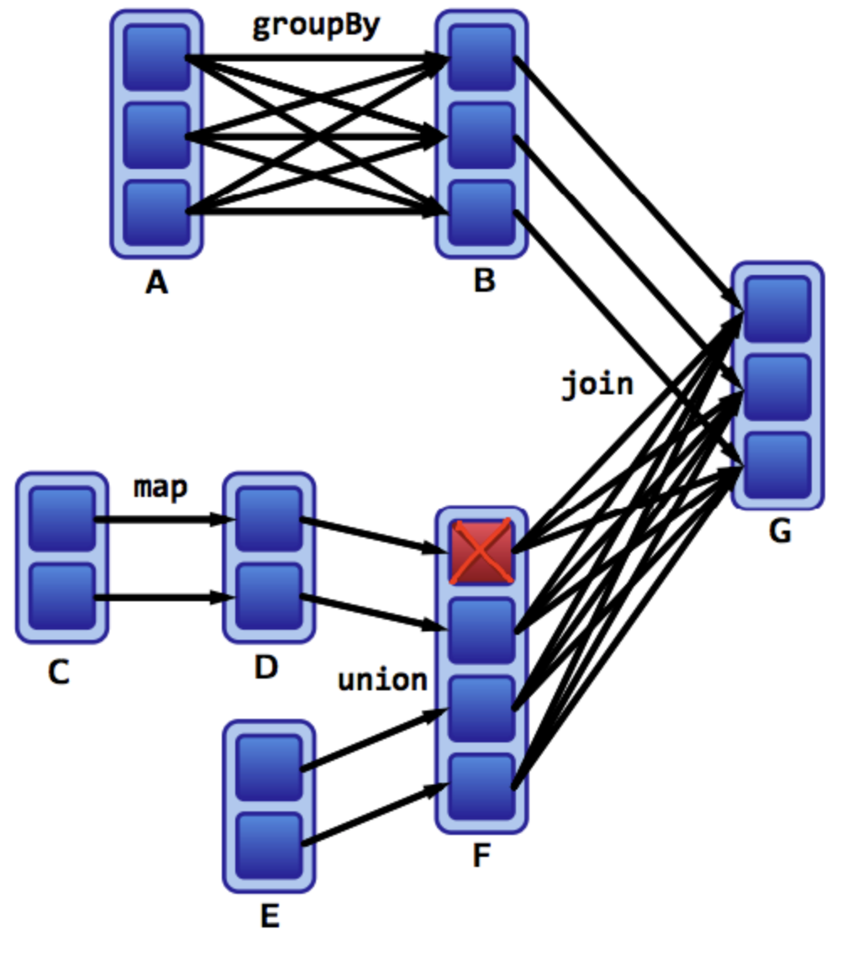
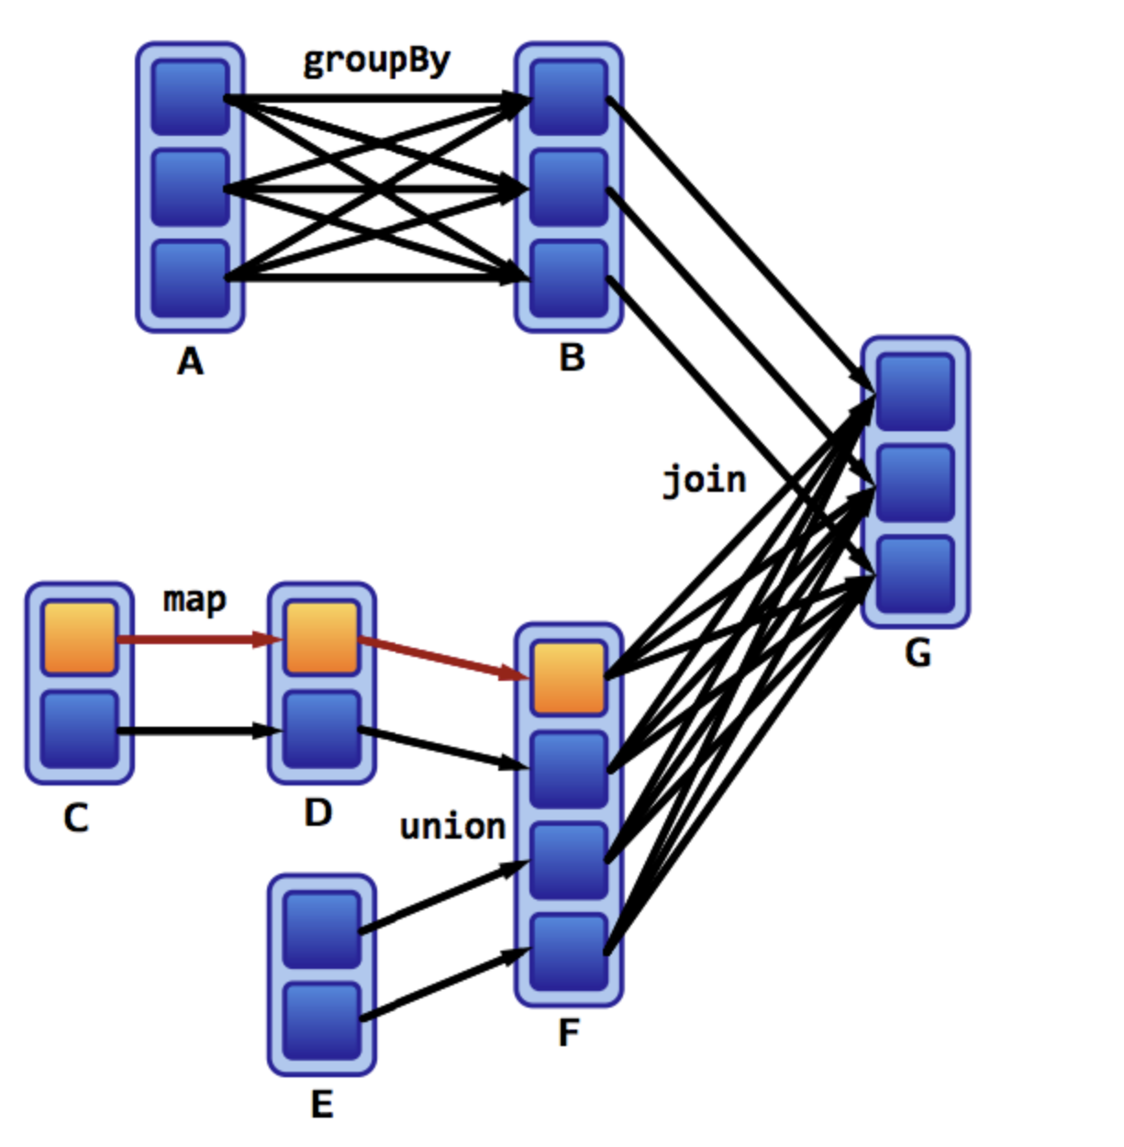
Failure handling
Can we have a duplicate copy of this cached partition

Slide 93
Storage Levels
Specifies how and where to cache the RDD.
Storage Level | Description
MEMORY_ONLY | Store RDD as deserialized Java objects in the JVM. If the RDD does not fit in memory, some partitions will not be cached.
MEMORY_AND_DISK | Store RDD as deserialized Java objects in the JVM. If the RDD does not fit in memory, store the partitions that don't fit on disk
MEMORY_ONLY_SER | Store RDD as serialized Java objects This is generally more space-efficient than deserialized objects But requires more CPU to deserialize
MEMORY_AND_DISK_SER | Spill partitions that don't fit in memory to disk
DISK_ONLY | Store the RDD partitions only on disk
MEMORY_ONLY_2 MEMORY_AND_DISK_2 etc... | Same as the levels above, but replicate each partition on two cluster nodes. Increases fault tolerance

Slide 94
Need to cache an RDD
Caching may require huge memory
RDD created from file
This is a better candidate for caching
Filtered RDD
It is appropriate to cache this RDD, to avoid shuffle
This will have even lower memory requirement
RDD with selected fields
Another RDD
Result RDD
Action
Action
Action

Slide 95
Points to know
Caching of RDD does not kick in until any action is called on it or any of its downstream descendent
Once RDD is cached, the details can be viewed from the Storage tab on the UI
Do not cache unnecessary data. Filter out records or fields not needed by downstream applications
Carefully choose the storage and replication level
Unpersist when cached data is not needed in the application
Un-persisting is instantaneous

Slide 96
One example
user_details
user_id,
user_name,
address
age
user_activity_003
Expected outcome:
Activity details enriched with name and age of the user
user_activity_002
user_activity_001
Need to join:
Static user_details with new user_activity file coming every 15 mins
user_activity (generated every 15 mins)
Contains:
timestamp,
activity type,
location
Updated once every day

Slide 97
One example
Possibilities:
Run the join every 15 mins
The user_details is a big file and needs to be read on every run
Cache the user_activity
Of less use, since once the result of join is gathered, that user_activity file is no longer processed by this application
Cache user_details
This is a better choice and will prevent reading the user_details file over and again.
A separate thread can reload that RDD once every day.
Still, there is shuffle involved during joins
Repartition and cache user_details
Repartition the user_details on the join column to be used while joining with new user_activity file.
The number of partitions of both RDD must be the same an integral multiple of each other.
Only the new incoming user_activity will be shuffled while joining and the bigger user_details file will remain cached and unshuffled leading to an even higher performance

Slide 98
One example
Repartition each incoming user_activity
Repartitioned
(on user_id) and cached RDD
join with other RDD on the same key
Repartition the bigger RDD on the join key
Cache the bigger RDD
On joining with the other dataset, repartition it on the join key before joining with bigger RDD

Slide 99
Next:
Accumulators

Slide 100
Use Case of Accumulator
We want to get the word-count from a file of sentences.
Our secondary expectation is to collect some additional metrics like:
Number of records processed
Number of empty lines
Number of lines with less than 5 words in them
Number of unparseable / invalid lines
Number of words which are more than 10 characters long
...

Slide 101
Use Case of Accumulator
We can run one action to collect each metric
Caching can help reduce the time taken in subsequent jobs
To capture metrics from a Spark Job, we can make use of distributed variables called accumulators. They can be used as counters inside each task and when the job completes the values can be brought at the driver to get the final result.
Multiple accumulators can be created by the same SparkContext.

Slide 102
How to create and use accumulators
An accumulator is created from an initial value v
SparkContext.accumulator(v)
Tasks running on a cluster can then add to it using the add method or the += operator.
Only the driver program can read the accumulator’s value, using its value method.

Slide 103
Further reading: Custom Accumulators
Accumulators in Spark

Slide 104
Next:
Running Spark on Cluster

Slide 105
Creating an EMR cluster
Create an EMR cluster
Enable Security Group on the master machine so that Web UI can be viewed
Ensure to have the key to ssh to the master
When using windows OS, have an SSH client like PuTTY or MobaXterm to login to remote machine

Slide 106
Deployment modes
Client mode
Driver application is launched on the same machine where spark-submit is called.
Not suited if multiple spark applications are going to be running at the same time.
Cluster mode
Driver application runs on one of the nodes in the cluster.
Suited if submitting the spark job from a gateway machine from where communication to executors has higher latency.

Slide 107
Syntax of running on cluster
./bin/spark-submit \
--class <main-class> \
--master <master-url> \
--deploy-mode <deploy-mode> \
--conf <key>=<value> \
... # other options
<application-jar> \
[application-arguments]
--class: The entry point for your application
--master: The master URL for the cluster
--deploy-mode: client (default) or cluster
--conf: spark configuration property in key=value format
application-jar: Path to a bundled jar including your application and all dependencies.
application-arguments: Arguments passed to the main method of your main class, if any

Slide 108
Viewing the UI
When using YARN, the UI of running applications is at
http://ip-of-master:8088/cluster/apps/RUNNING

Slide 109
Reference
Submitting Applications - Spark 3.0.0 Documentation

Slide 110
Next:
Credit Card Transaction Analysis with Spark Core

Slide 111
Understanding the problem
Read the file from in the notebook
File has json records
Each record has fields:
user_id
card_num
merchant
category
amount
ts
For the one month (1st Feb to 29th Feb 2020: 1580515200 <= ts < 1583020800), perform below analysis:
Get the total amount spent by each user
Get the total amount spent by each user for each of their cards
Get the total amount spent by each user for each of their cards on each category
Get the distinct list of categories in which the user has made expenditure
Get the category in which the user has made the maximum expenditure

Slide 112
Next:
Solution

Slide 113
Using groupByKey to get all the distinct values
RDD of user and category
RDD of having all the categories grouped by user
U1, C1
U1, C2
U1, C1
U2, C2
U2, C2
U2, C2
U1, C1
U1, C1
U1, C1
U2, C2
U2, C3
U2, C3
Perform distinct operation on the list of values
U1, [C1, C2, C1, C1, C1, C1]
Limitation
Materializing the iterator into a list can give out of memory error for large number of values
Large amount of shuffle data
U2, [C2, C2, C2, C2, C3, C3]

Slide 114
Passing combiner with combineByKey
Combiner is called before shuffle
For each key if it is seen for the first time create a set with the value seen
If the key has already been seen, update the corresponding set
After shuffle, merge all the sets for each key
RDD of user and category
U1, C1
U1, C2
U1, C1
U2, C2
U2, C2
U2, C2
U1, C1
U1, C1
U1, C1
U2, C2
U2, C3
U2, C3
U1, set(C1)
U1, set(C1, C2)
U1, set(C1, C2)
U2, set(C2)
U2, set(C2)
U2, set(C2)
Assume it has two partitions
For U1, merge set(C1, C2) with set(C2)
U1, set([C1, C2])
U1, set(C1)
U1, set(C1)
U1, set(C1)
U2, set(C2)
U2, set(C2, C3)
U2, set(C2, C3)
For U2, merge set(C2) with set(C2, C3)
U2, set([C2, C3])

Slide 115
Next:
Loan Application Data Analysis with Spark Core

Slide 116
Understanding the problem
Input
Configuration File
It consists of
input file location
output file location
delimiter in the actual data file
Get the configuration file from the DBFS
Auto Loan Datasets
application_id
customer_id
car_price
car_model
customer_location
request_date
loan_status
Perform following analysis
The month in which maximum loan requests were submitted in the last one year [2019-04-01 to 2020-03-31]
Max, Min and Average number of applications submitted per customer id
Top 10 highest car price against which applications got approved
For each customer location, top 5 car models which have most loan applications in the last month

Slide 117
Next:
Solution

Slide 118
Using groupByKey to get top N values
RDD with state, car type and number of applications
RDD created after groupByKey operation with state as the key
Perform sort operation on the values (descending order of the number of applications) and get the top N
S1, C1, 10
S1, C2, 12
S1, C3, 8
S1, C4, 14
S2, C1, 9
S2, C2, 19
S2, C3, 20
S2, C4, 11
S1, [(C1, 10), (C2, 12), (C3, 8), (C4, 14)]
groupByKey
Limitation
Materializing the iterator into a list can give out of memory error for large number of values
S2, [(C1, 9), (C2, 19), (C3, 20), (C4, 11)]

Slide 119
Using secondary sort to order values
RDD with state, car type and number of applications
RDD created after secondary sort with (state, num applications) as key (sorted in descending order) and state to decide partitions
S1, C1, 10
S1, C2, 12
S1, C3, 8
S1, C4, 14
S2, C1, 9
S2, C2, 19
S2, C3, 20
S2, C4, 11
Perform mapPartitions to get the top N for each state
repartitionAndSortWithinPartitions
Composite key:
state + num applications
Partition By:
State
Order:
Descending
S1, 14, C4
S1, 12, C2
S1, 10, C1
S1, 8, C3
Makes use of the sorting the keys during the shuffle, hence no extra overhead
Iterator of values is not materialized
S2, 20, C3
S2, 19, C2
S2, 11, C4
S2, 9, C1

Slide 120
Next:
Tips on tuning Spark Application
[Choosing size of executors]

Slide 121
Setting configurations in Spark Application
In an application
conf = SparkConf()
conf.set("spark.task.maxFailures", "2")
conf.set("spark.speculation", "true")
sc = SparkContext(conf) ...
At runtime (spark-submit)
spark-submit \
--conf spark.task.maxFailures=2 \
--conf spark.speculation=true ...

Slide 122
Spark Memory Model
yarn.nodemanager.resource.memory-mb [controls the maximum sum of memory used by the containers on each node]
Executor Container
spark.yarn.executor.memoryOverhead
added to the executor memory to determine the full memory request to YARN for each executor
defaults to max(384, .07 * spark.executor.memory)
spark.executor.memory [controls the executor heap size, but JVMs can also use some memory off heap]
spark.shuffle.memoryFraction
spark.storage.memoryFraction

Slide 123
Starting point of the number of executors
Deciding the number and size of executors
--num-executors
--executor-cores
--executor-memory
Take care of below points:
--executor-cores decides number of tasks running in that executor in parallel

Slide 124
Starting point of the number of executors
For better HDFS throughput, recommendation is to use 4-5 --executor-cores
A thin executor with lesser --executor-core and --executor-memory, cache of the executors will be underutilised. We won’t benefit from running multiple tasks in the JVM. Eg: multiple copies of the broadcast variables will be sent.
A fat executor with higher --executor-core and --executor-memory will lead to poor throughput
In YARN
Application Master will also need 1 CPU core
7% overhead memory is provided to the executors

Slide 125
Starting point of the number of executors: Sample
With 6 machines each having 16 cores and 64 GB of RAM
Leave out 1 core and 1 GB of RAM for the OS related process on those machines
With 5 tasks per executor, we can choose to run 3 executors on each machine, so that each task on the executor can use 1 core. Hence --executor-cores can be 5
A total of 18 executors can be used. Since, application master also uses one core, we can use --num-executors to be 17
63 GB of RAM across 3 executors, means each executor can have 63/3 GB (= 21GB) of memory, since YARN introduces overhead of 7%, we can choose --executor-memory to be 19 GB. (exact number is around 19.5GB)

Slide 126
Things we overlooked
We are giving one executor resource (5 cores and 19 GB of RAM) to Application Master which is a lot. Most of the time AM is fine with 1 GB and 1 core. So, update the calculation accordingly.
If job is not CPU intensive, each task in the executor need not have 1 CPU core. Hence, even if one executor gets 2 physical CPU cores, it can run more than 2 tasks.
Monitor the performance the RAM utilisation (using spark JVM metrics) to tune the numbers further.
If a machine has 22 GB of RAM and we are running 2 executors each using 8 GB (including overhead), then a request for running third executor with 8 GB RAM will not granted and the remaining 6 GB will be unutilised. So, ensure RAM on the machine is a close multiple of executor memory (with overhead)

Slide 127
Next:
Tuning Spark Application
[Dynamic Allocation]

Slide 128
Dynamic Allocation
One spark application consists of multiple jobs, each can have different requirement for the number of executors
Static values of number of executors can be many a time too high or too low
Driver should request for more executors if there are tasks pending or kill executors if idle for long.

Slide 129
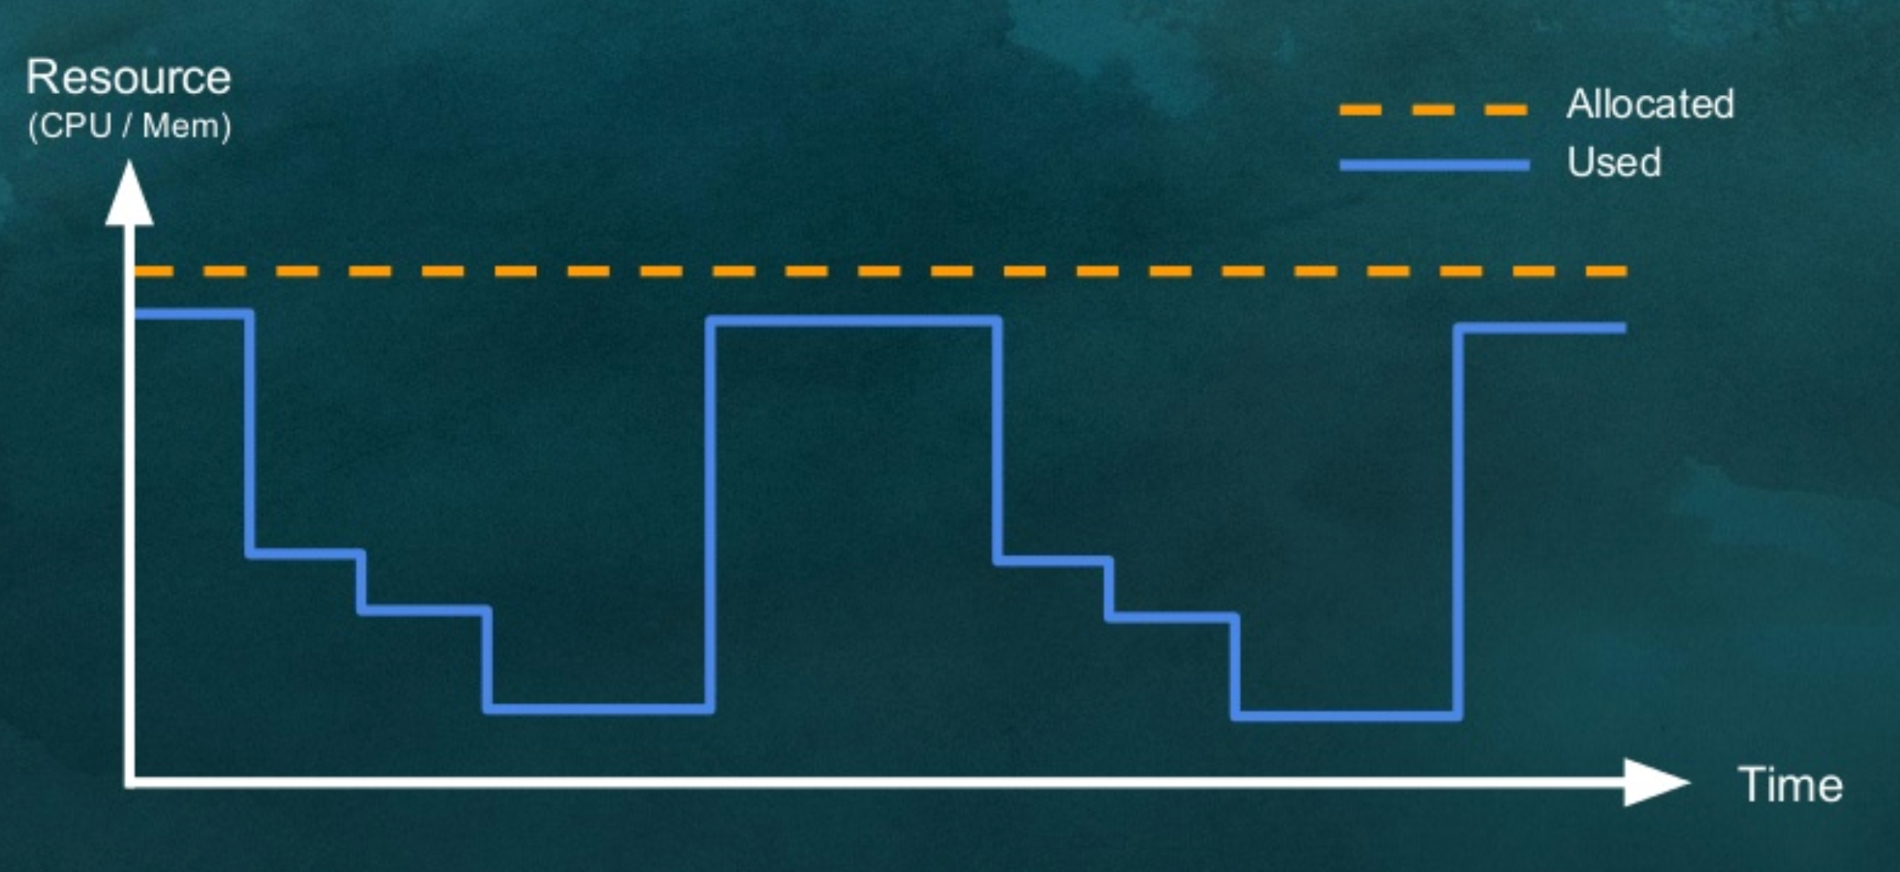
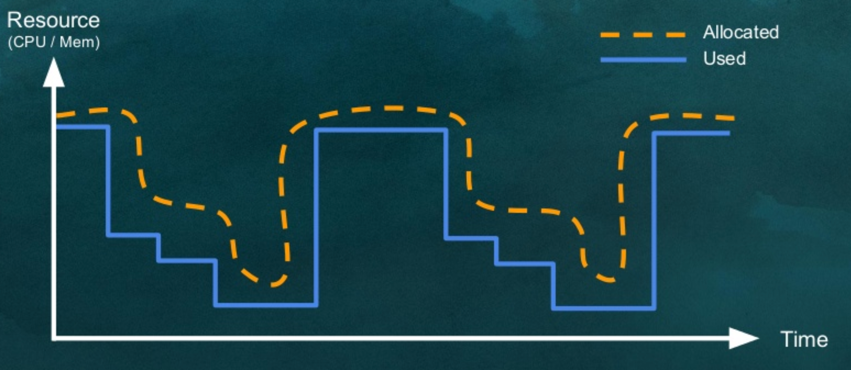
Dynamic Allocation
Static Allocation
Dynamic Allocation

Slide 130
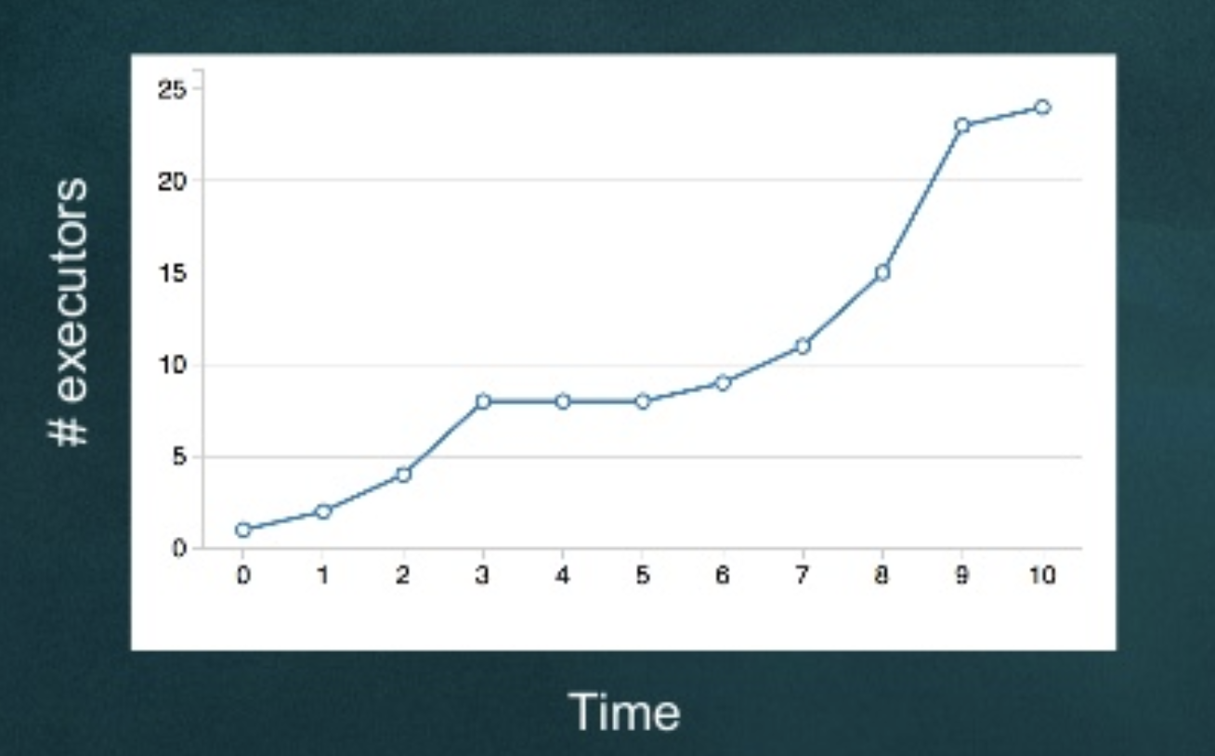
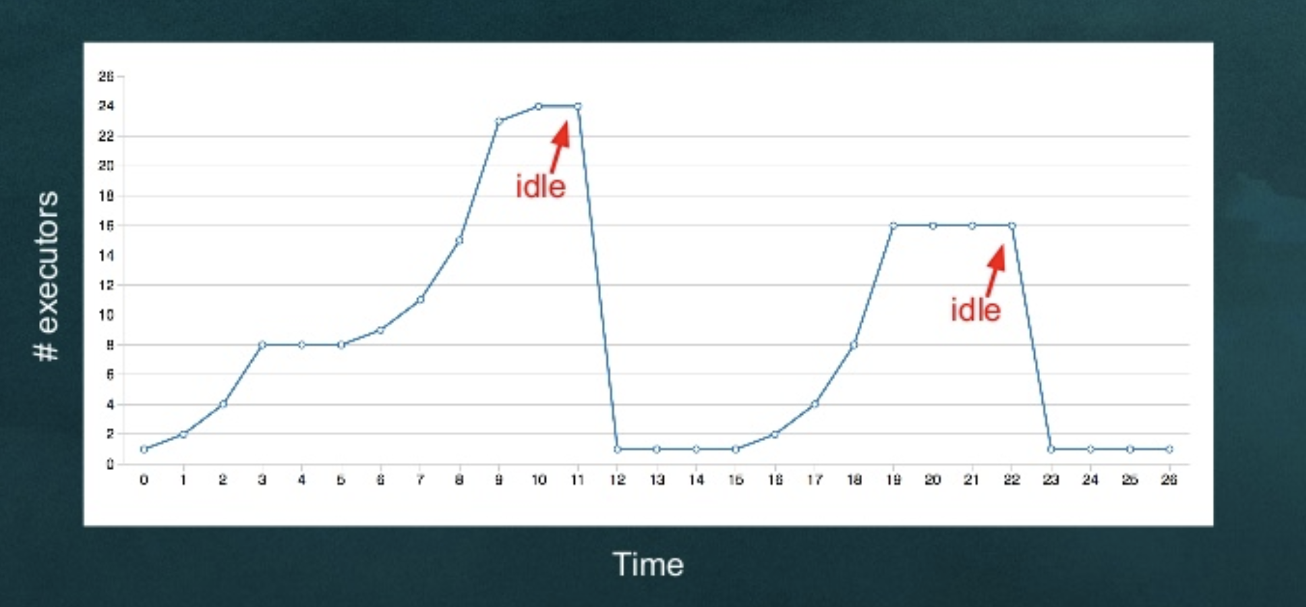
Dynamic Allocation
Add executors when more tasks are pending
Remove executors when it remains idle for long

Slide 131
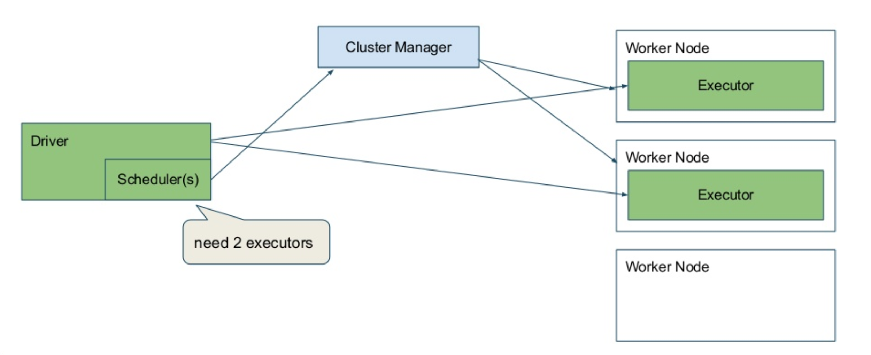
Dynamic Allocation

Slide 132
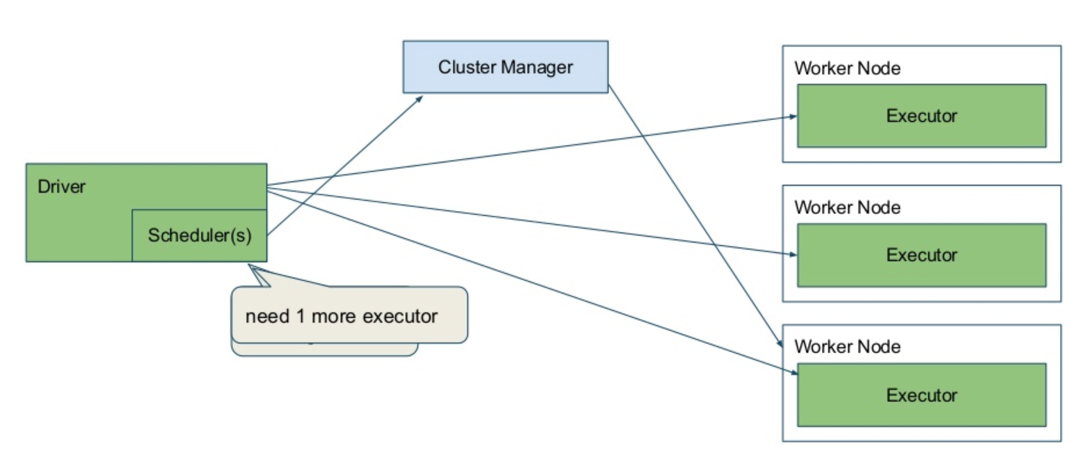
Dynamic Allocation

Slide 133
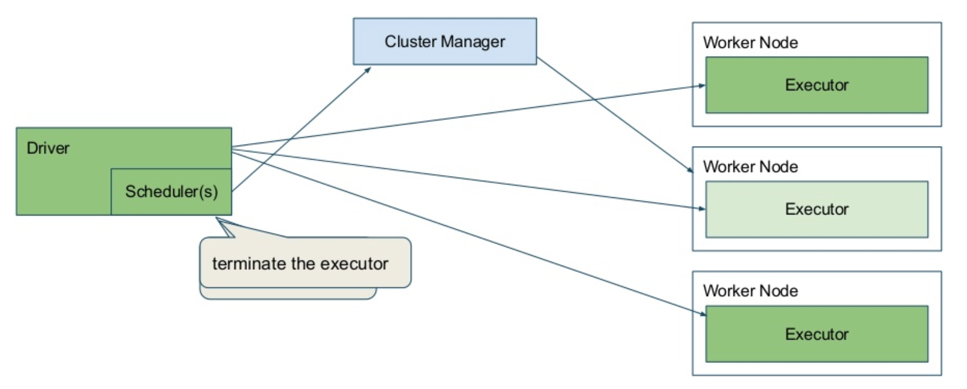
Dynamic Allocation

Slide 134
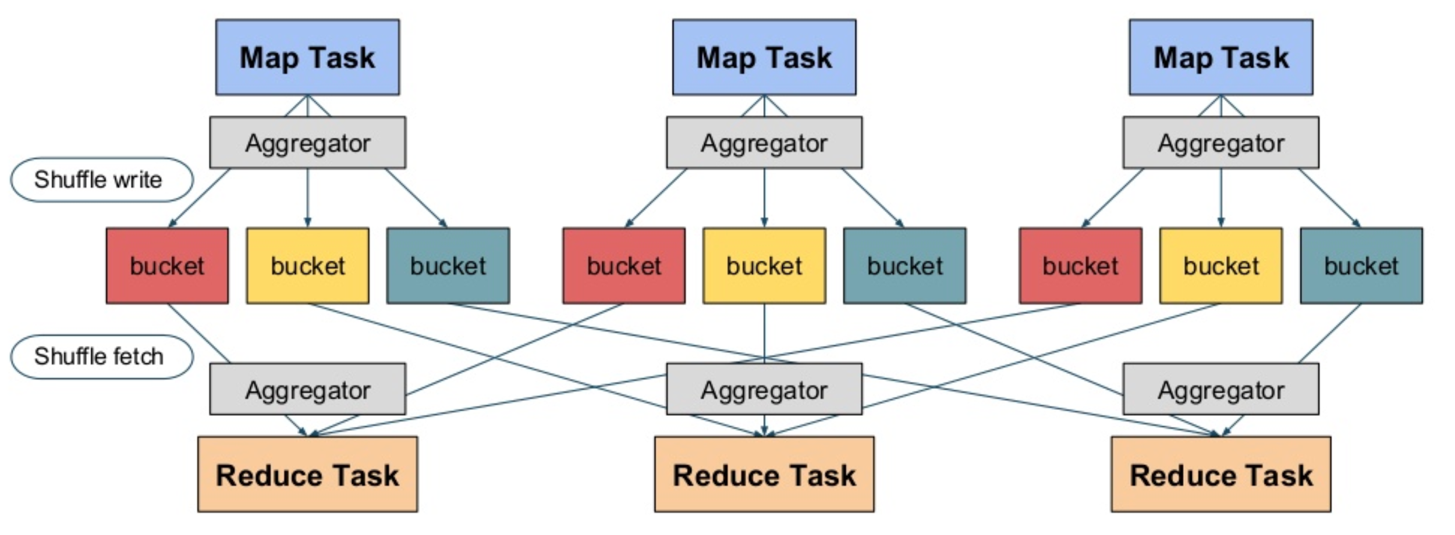
Dynamic Allocation: External Shuffle Service

Slide 135
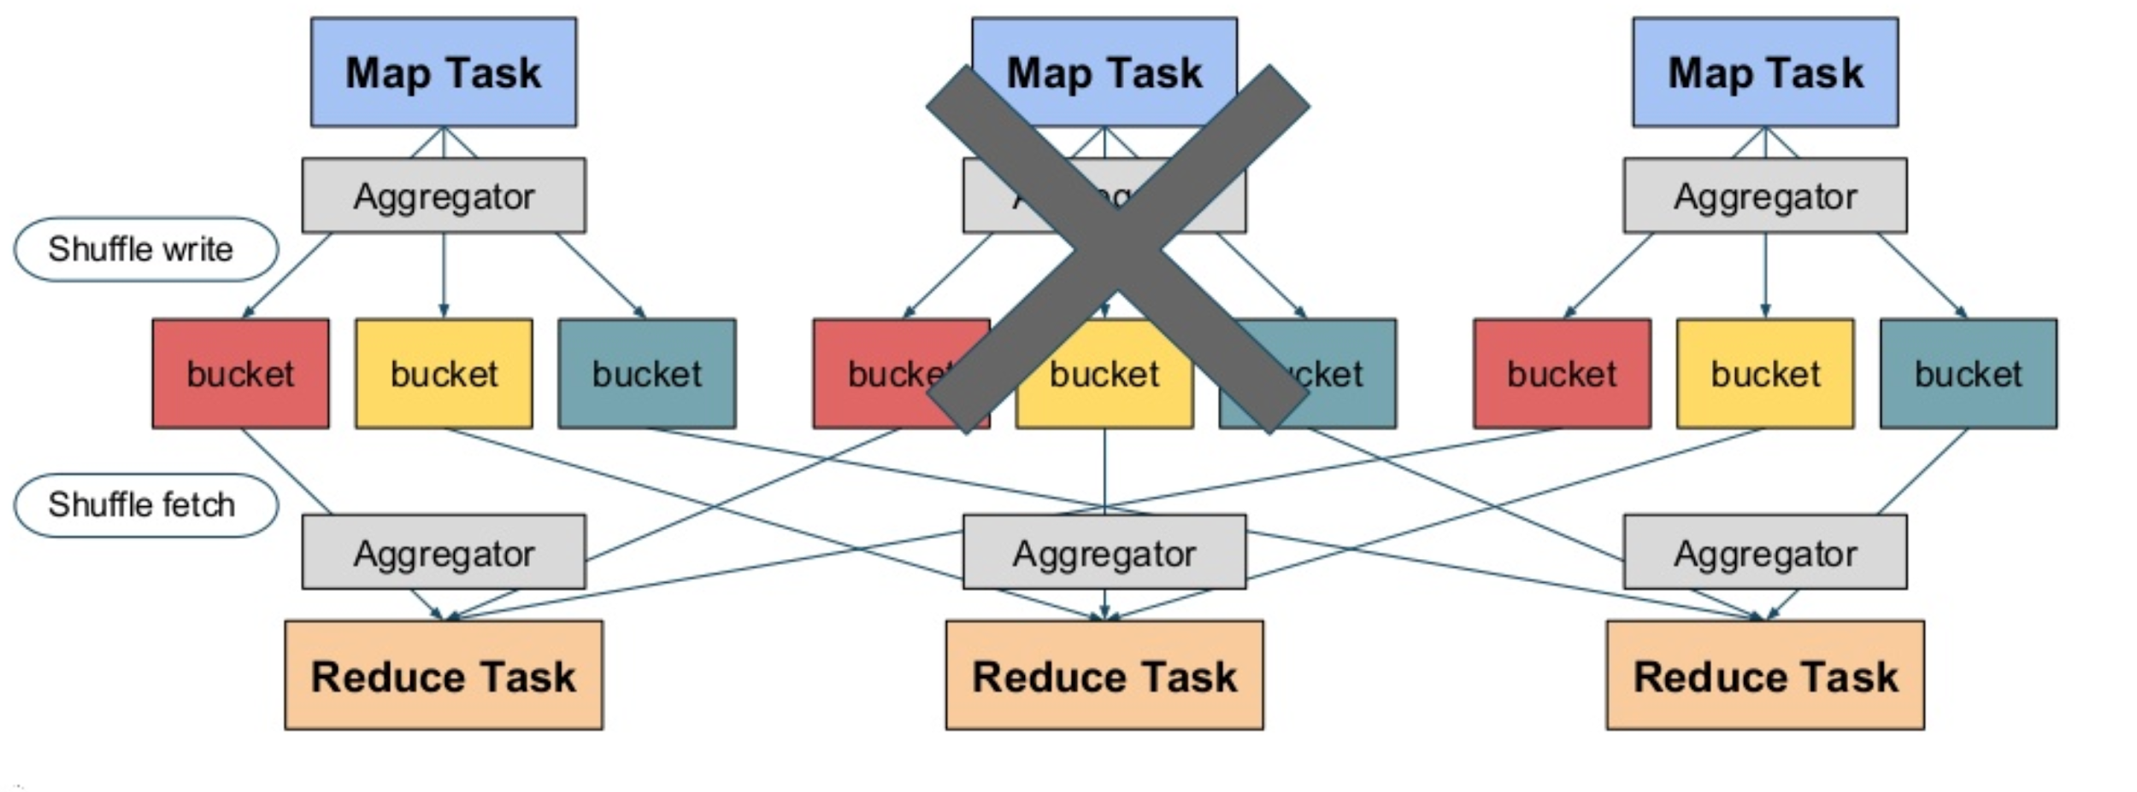
Dynamic Allocation: External Shuffle Service

Slide 136
Dynamic Allocation: External Shuffle Service
If an executor is killed, the shuffle data it had also gets deleted
This may impact further stages of the job
Solution: Extract shuffle service away from executors
External shuffle service will manage local aggregated data across shuffles
Maintain data until application is done
Use carefully for streaming/long running tasks, since the disk can run out of space

Slide 137
Dynamic Allocation: Configurations
Configuration | Description
spark.dynamicAllocation.enabled | Whether to use dynamic resource allocation
spark.dynamicAllocation.initialExecutors | Initial number of executors to run if dynamic allocation is enabled
spark.dynamicAllocation.maxExecutors | Upper bound for the number of executors if dynamic allocation is enabled
spark.dynamicAllocation.minExecutors | Lower bound for the number of executors if dynamic allocation is enabled

Slide 138
Dynamic Allocation: Configurations
Configuration | Description
spark.dynamicAllocation.executorIdleTimeout | If dynamic allocation is enabled and an executor has been idle for more than this duration, the executor will be removed
spark.dynamicAllocation.schedulerBacklogTimeout | If dynamic allocation is enabled and there have been pending tasks backlogged for more than this duration, new executors will be requested
spark.dynamicAllocation.sustainedSchedulerBacklogTimeout | Time to wait between subsequent executor requests

Slide 139
Dynamic Allocation: Configurations
Configuration | Description
spark.shuffle.service.enabled | Enables the external shuffle service
spark.shuffle.service.port | Port on which the external shuffle service will run

Slide 140
Next:
Tuning Spark Application
[Handling Skewness]

Slide 141
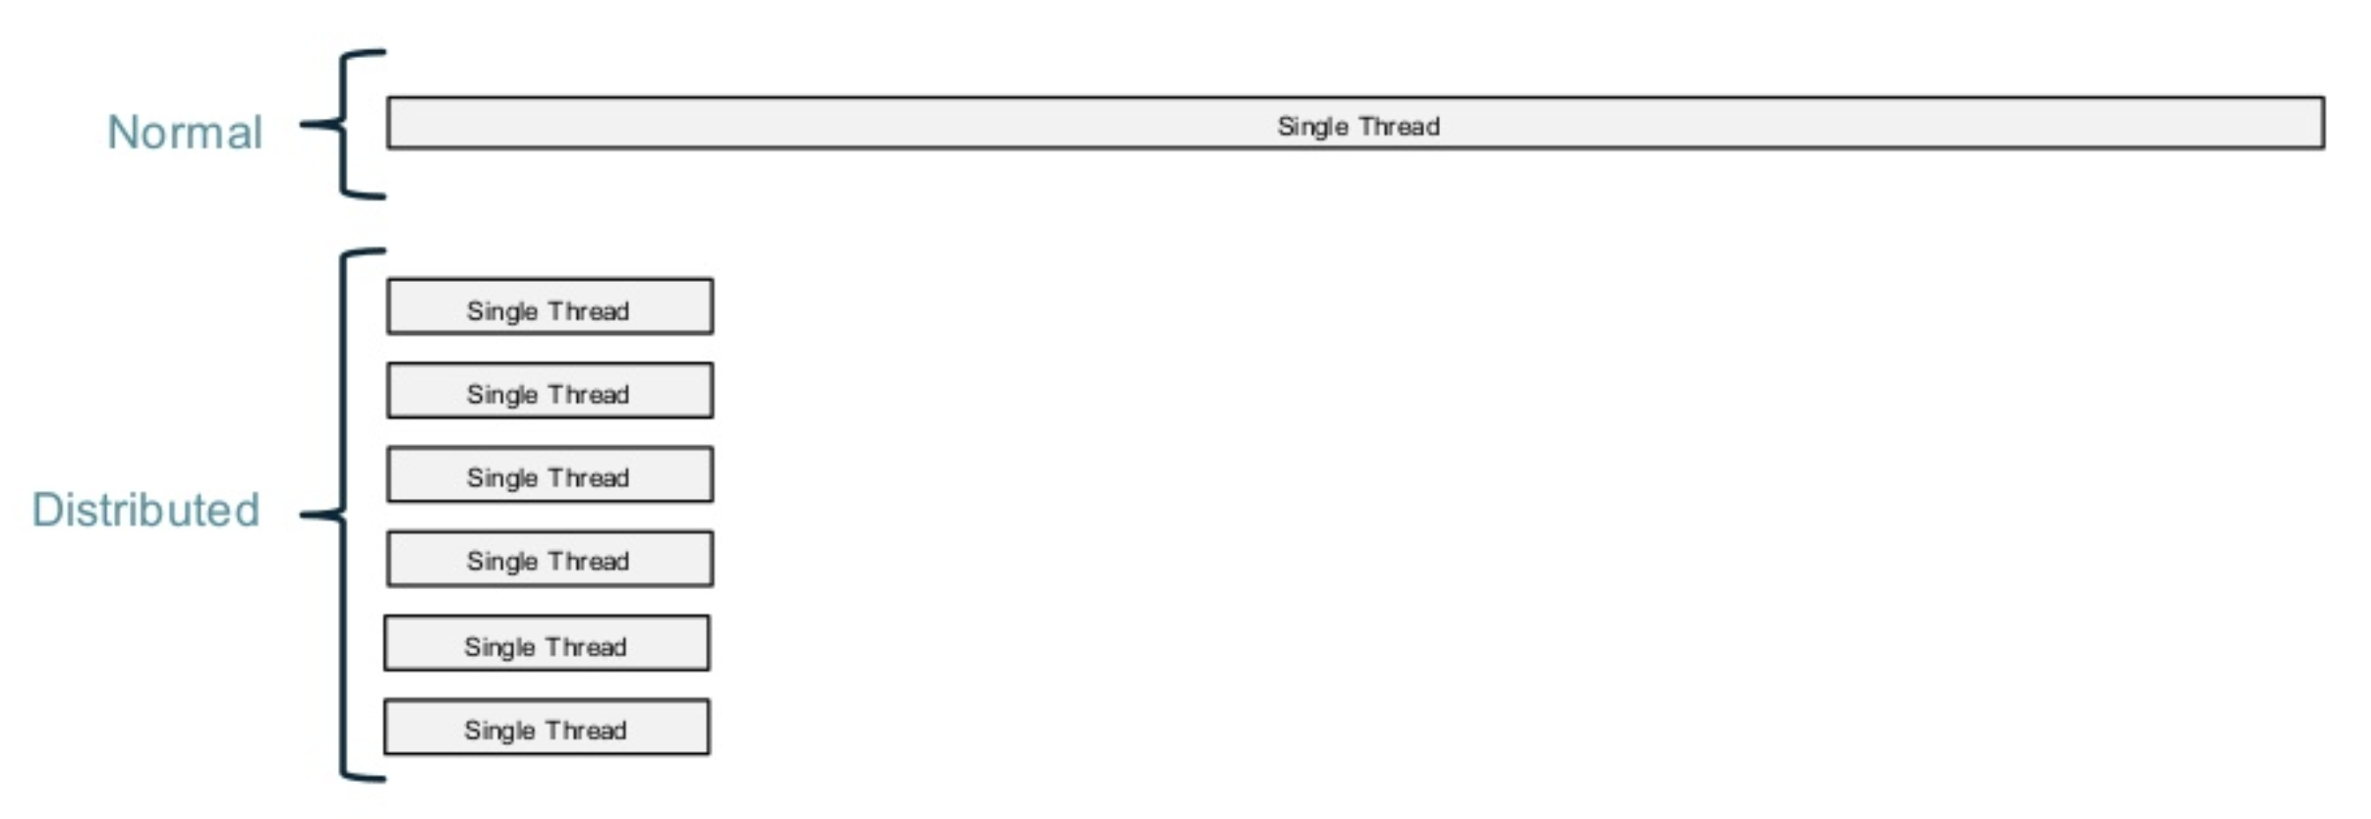
Handling Skewness
Expectation from distributed processing

Slide 142
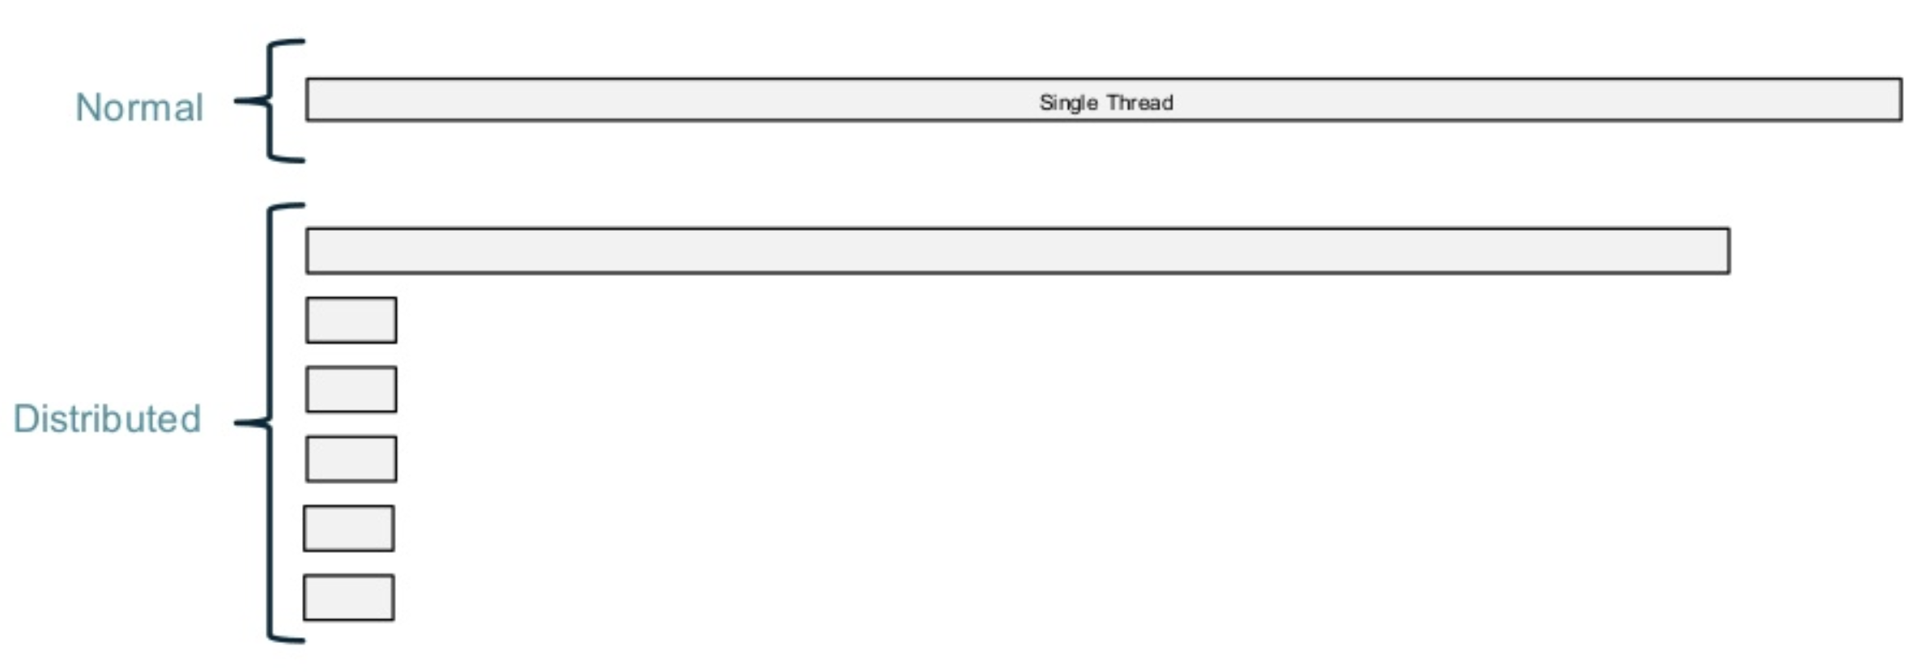
Handling Skewness
Result of skewness
One machine doing the most of the work

Slide 143
Handling skewness in processing
Repartitioning
Increase the number of partitions using repartition() method over the RDD.
When deciding the number of partitions in the output child RDD, as a rule of thumb 128 MB or 256 MB should be the size of each child partition.
If you happen to use close to but less than 2000 partitions, then use at least 2000 partitions for better compression of the shuffle block
Use of combiner
If there are many records of the same key, repartition does not help
Combiners sharply decrease the size of shuffle data and reduces the load during aggregation.

Slide 144
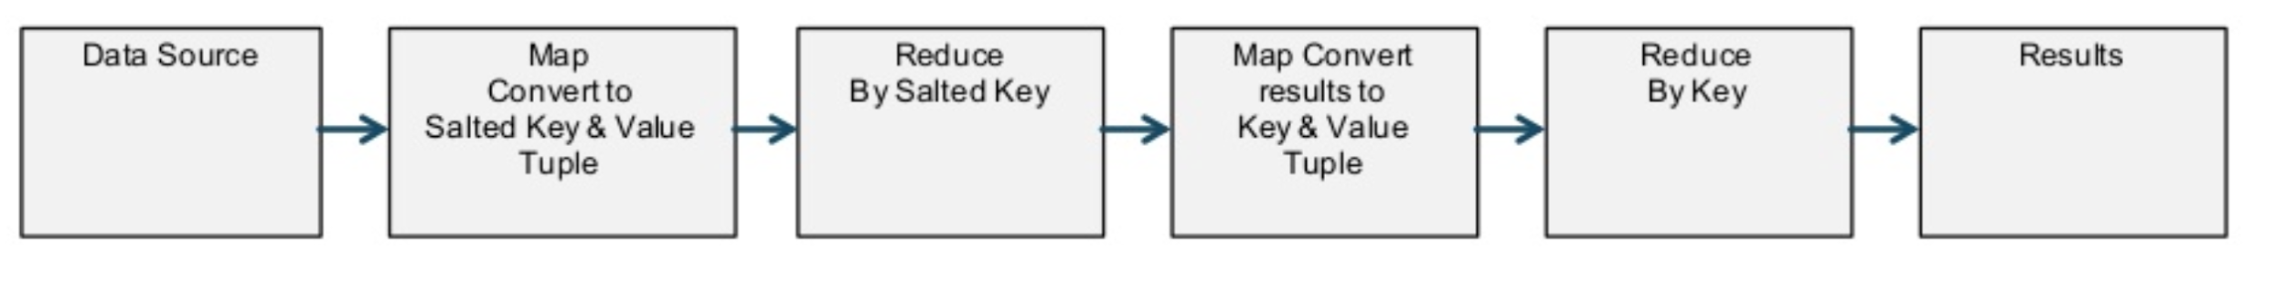
Handling skewness in aggregates: Salting
If control over combiner and how many times it runs is limited, use two phase aggregation by using salting
Salting is adding some random prefix or suffix in the original key
Eg: if key is “Stockholm” with radomness of 10 integers, we can get keys Stockholm_0, Stockholm_1, …, Stockholm_9. Here, _0, _1 etc are the salts.
With salting, a single key can get spread across multiple machines.
Do the aggregation and in the second phase remove the salt to do final aggregation over the actual key. The first phase of the aggregation acts like the combiner and reduces load on the second phase.

Slide 145
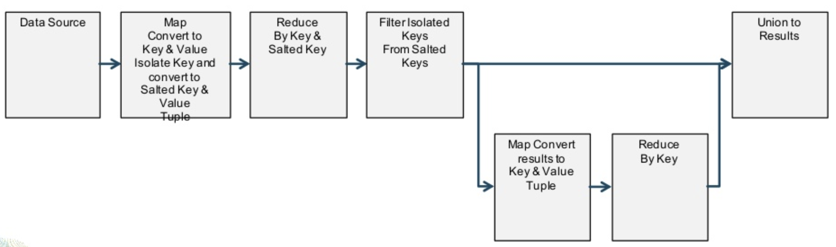
Handling skewness in aggregates: Salting
Instead of salting all the keys, construct two RDDs one with normal keys and one with skewed keys
Perform two-phase aggregation only for the salted keys and merge the results.

Slide 146
Handling skewness in joins: MapSide Join
Construct 2 RDDs for each source
One with normally distributed keys
One with skewed keys
Apply corresponding filter on the other RDD as well
For normal keys, use Hash Join and Map Join for skewed key
Hash join for normal keys
Data Source
Filter normal and skewed keys
Union the results
Map side join for skewed keys

Slide 147
Next:
Tuning Spark Application
[Miscellaneous]

Slide 148
Using coalesce
EMPTY
EMPTY
EMPTY
EMPTY

Slide 149
Using coalesce
When some empty or light files are produced after the final processing, use coalesce.
coalesce is preferred over repartition if we have to reduce the count of partitions in an RDD.
As a rule of thumb, each output file should be around 128 MB or 256 MB, if that is not the case, use coalesce in the stage of the pipeline where partitions in the output have much lesser or no data at all.
This avoids running unnecessary tasks which do almost nothing.

Slide 150
Using coalesce
coalesce(2)
Less tasks
launched
afterwards
EMPTY
EMPTY

Slide 151
Avoiding Shuffles
When joining a bigger dataset frequently with smaller datasets on the same key, look for opportunity to avoid shuffle
Repartitioned
(on user_id) and cached RDD
multiple joins with other RDDs on the same key
Repartition the bigger RDD on the join key
Cache the bigger RDD
On joining with the other dataset, repartition it on the join key before joining with bigger RDD

Slide 152
Avoiding Shuffles
Prefer secondary sort for operations like topN for each key
Prefer reduceByKey or combineByKey over groupByKey as the former reduces the amount of data that gets shuffled

Slide 153
Avoid collecting larger results in memory
Avoid using collect
Can lead to out of memory on driver
Alternatives to view limited data:
sample
take

Slide 154
Avoid unnecessary actions
Each action triggers one Spark job
Think of caching the RDD if multiple actions are needed
Metrics which can be collected via accumulators can avoid additional actions
If we need to check if an RDD is empty or not:
Instead of using if rdd.count() > 0
Use, if len(rdd.take(1)) > 0
count will scan entire RDD, whereas take() will just read only those partitions from where results can be retrieved.

Slide 155
Choosing better storage levels while caching
MEMORY_ONLY is the fastest way to read the RDD
Think of MEMORY_ONLY_SER or MEMORY_AND_DISK, if RAM is not enough
Use the replicated storage levels like MEMORY_ONLY_2 if the RDD is critical for downstream RDDs and RAM is sufficient
If multiple actions can be avoided, caching the RDD should also be considered not to be used.

Slide 156
Testing on local than on cluster
Usually cluster is shared across multiple applications
Test the logic on the local using pyspark --master local[1]
Encourage writing unit tests while developing the application

Slide 157
Shading the third party jar
Spark internally has dependency over lots of third party jars eg: fasterxml.jackson
When using Maven or SBT project, which has dependency over a different version of the same jar, use shading to avoid conflict.
Maven Shade Plugin Example
Shading Dependencies in Spark Projects with SBT

Slide 158
Tuning Spark: Further Reading
Apache Spark Core—Deep Dive—Proper Optimization
Introduction - Apache Spark - Best Practices and Tuning
Top 5 Mistakes When Writing Spark Applications

Slide 159

Reference Book

